Slide 1




MMC vs MNA prof. Joseph MORLIER phd candidate Simone CONIGLIO Herraz Mahfoud

Slide 2
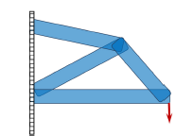
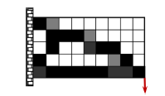
Explicit vs Implicit topology optimization
Explicit (MMC, MNA)
Implicit (SIMP, level set method)
geometrical design variables
Structure’s shape directly determined from design variables
density variables/nodal value of implicit function
Structure’s shape determined via density field (or level set function)
(GUO et al. 2015) A new topology optimization approach based on Moving Morphable Components (MMC) and the ersatz material model

Slide 3
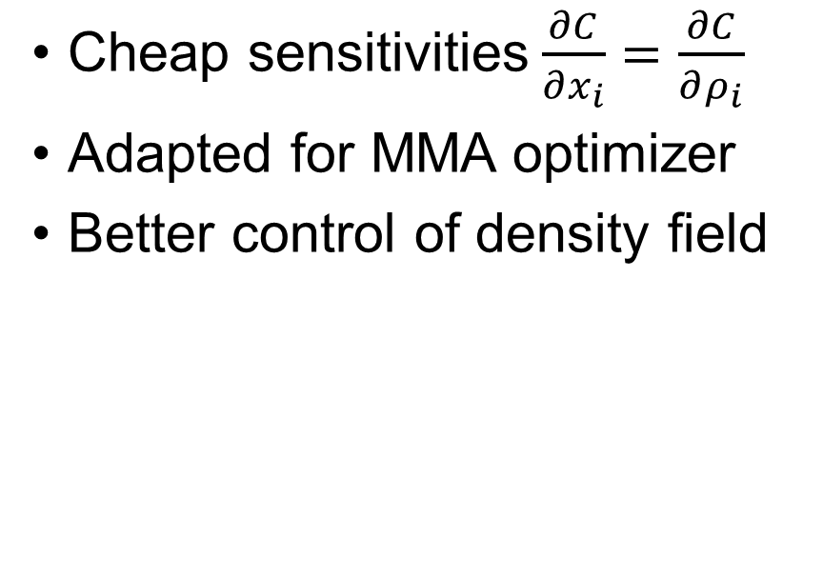
Pros and Cons (Implicit)
Advantages
Drawbacks
Cheap sensitivities$\frac{∂C}{∂x_{i}}=\frac{∂C}{∂ρ_{i}}$
Adapted for MMA optimizer
Better control of density field
High mesh dependency
Numerical instabilities (checkerboard patterns)
Post-processing needed for CAD design
High resolution increases design variables number

Slide 4
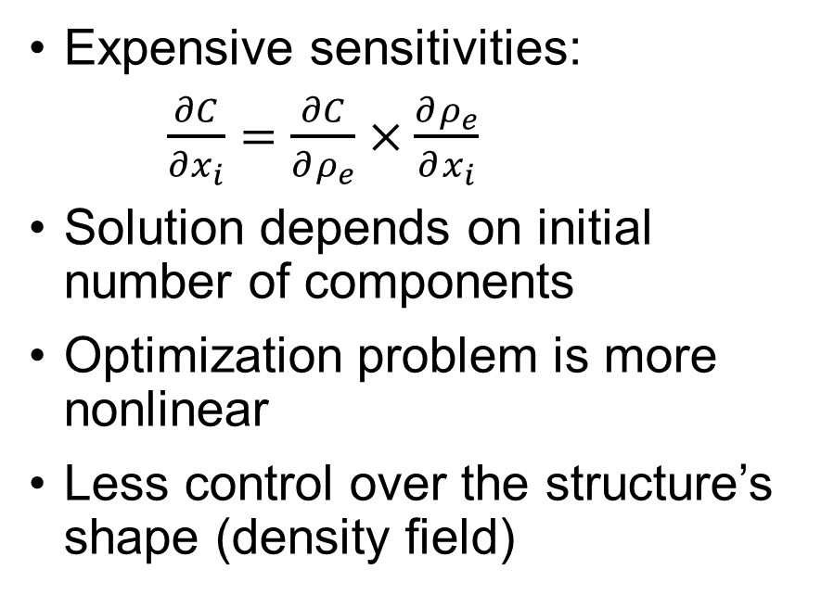
Pros and Cons (Explicit)
Advantages
Drawbacks
Adapted for CAD
Small number of design variables
Less mesh dependency (no filtering)
Resolution and variables number independent
Expensive sensitivities:
$\frac{∂C}{∂x_{i}}=\frac{∂C}{∂ρ_{e}}×\frac{∂ρ_{e}}{∂x_{i}}$
Solution depends on initial number of components
Optimization problem is more nonlinear
Less control over the structure’s shape (density field)

Slide 5
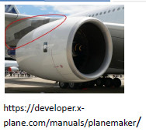
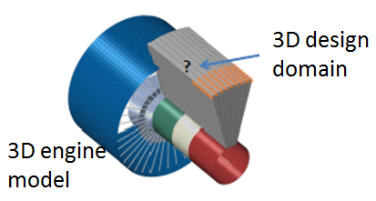
Airbus project (Simone’s thesis)
Pylon and engine mounts performance dirven structural topology optimization
Engine model and design domain mesh
made using ABAQUS
CONIGLIO et al. ORIGINAL PYLON ARCHITECTURE DESIGN USING 3D HPC TOPOLOGY OPTIMIZATION

Slide 6
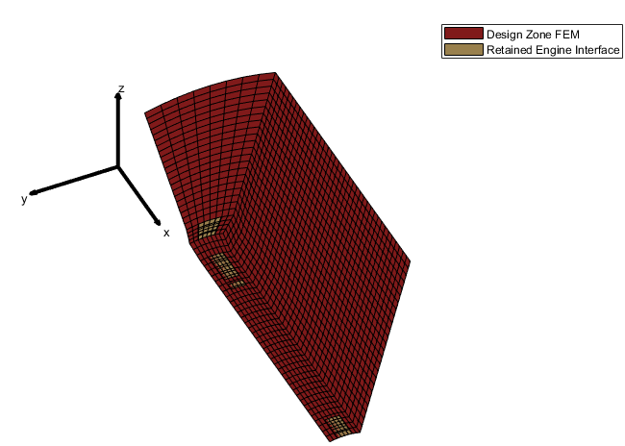
Airbus project (Simone’s thesis)
Hypothesis:
Pure axial thrust is applied to the engine
Static load (steady state conditions)
The wing is considered fixed
Engine architecture is unchanged,
so that engine model can be
condensated

Slide 7
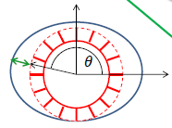
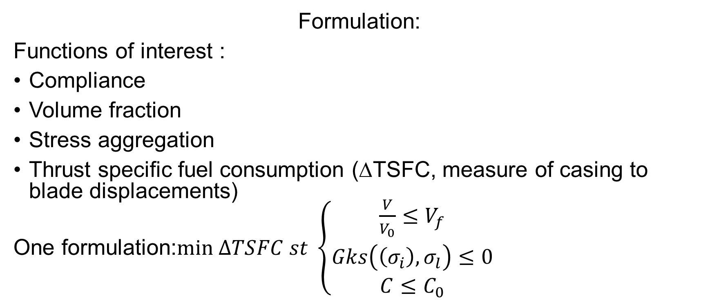
Airbus project (Simone’s thesis)
Formulation:
Functions of interest :
Compliance
Volume fraction
Stress aggregation
Thrust specific fuel consumption (∆TSFC, measure of casing to blade displacements)
One formulation:$min ΔTSFC st \left\{\begin{matrix}\frac{V}{V_{0}}≤V_{f} \\ Gks\left(\left(σ_{i}\right),σ_{l}\right)≤0 \\ C≤C_{0}\end{matrix}\right.$
Coniglio, S., Gogu, C., Amargier, R., and Morlier, J., “Pylon and engine mounts performance driven structural topology optimization,” WCSMO12 12thWorld Congress of Structural and Multidisciplinary Optimization 5 - 9 June 2017, Braunschweig,
Germany, 2017
7

Slide 8
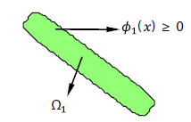
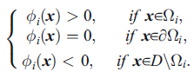
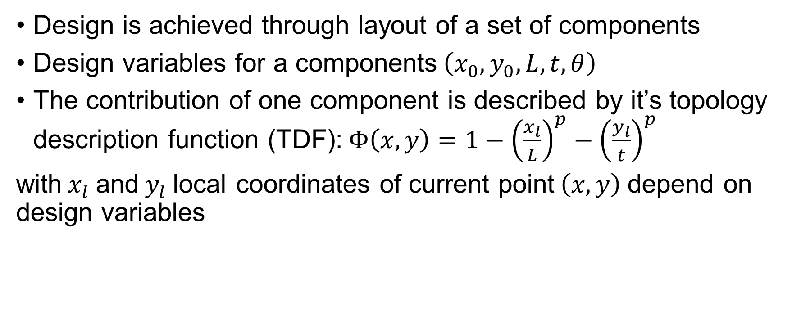
MMC scheme
Design is achieved through layout of a set of components
Design variables for a components$\left(x_{0},y_{0},L,t,θ\right)$
The contribution of one component is described by it’s topology description function (TDF):$Φ\left(x,y\right)=1−{\left(\frac{x_{l}}{L}\right)}^{p}−{\left(\frac{y_{l}}{t}\right)}^{p}$
with$x_{l}$and${ y}_{l}$local coordinates of current point$\left(x,y\right)$depend on design variables
(Guo et al. 2014) Doing Topology Optimization Explicitly and Geometrically-A New Moving Morphable Components Based Framework

Slide 9
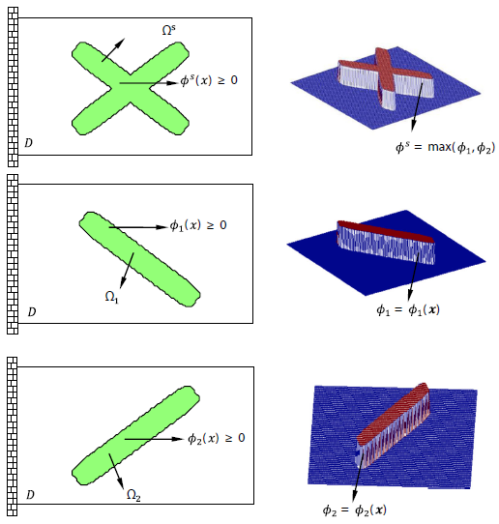
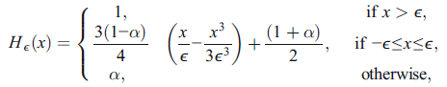
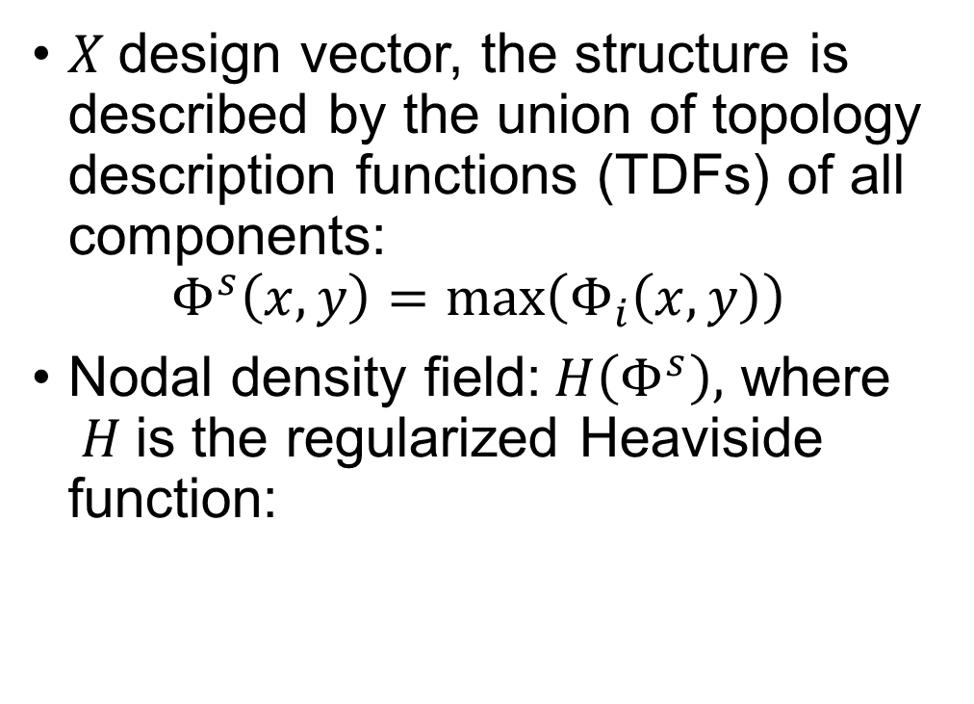
MMC scheme
(Guo et al. 2014) Doing Topology Optimization Explicitly and Geometrically-A New Moving Morphable Components Based Framework
$X$design vector, the structure is described by the union of topology description functions (TDFs) of all components:
$$Φ^{s}\left(x,y\right)=\max\left(Φ_{i}\left(x,y\right)\right)$$
Nodal density field:$H\left(Φ^{s}\right),$ where $H$is the regularized Heaviside function:

Slide 10
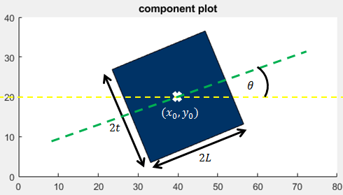
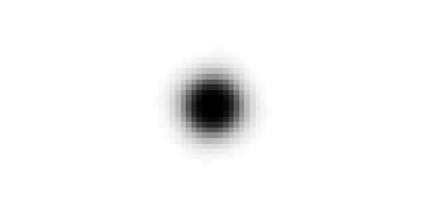
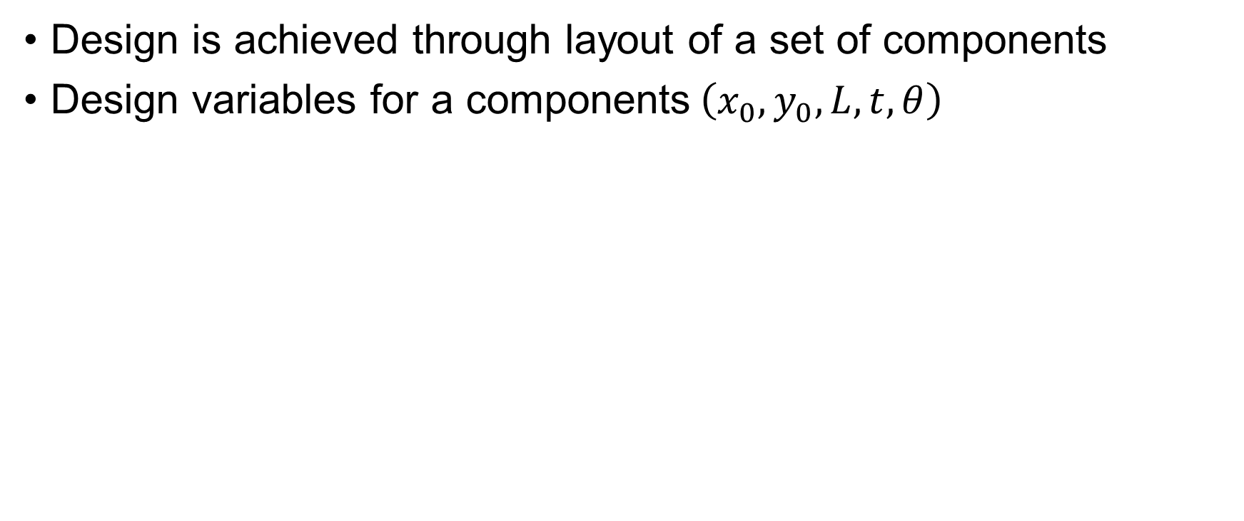
MNA scheme
Design is achieved through layout of a set of components
Design variables for a components$\left(x_{0},y_{0},L,t,θ\right)$
Density field of a component

Slide 11
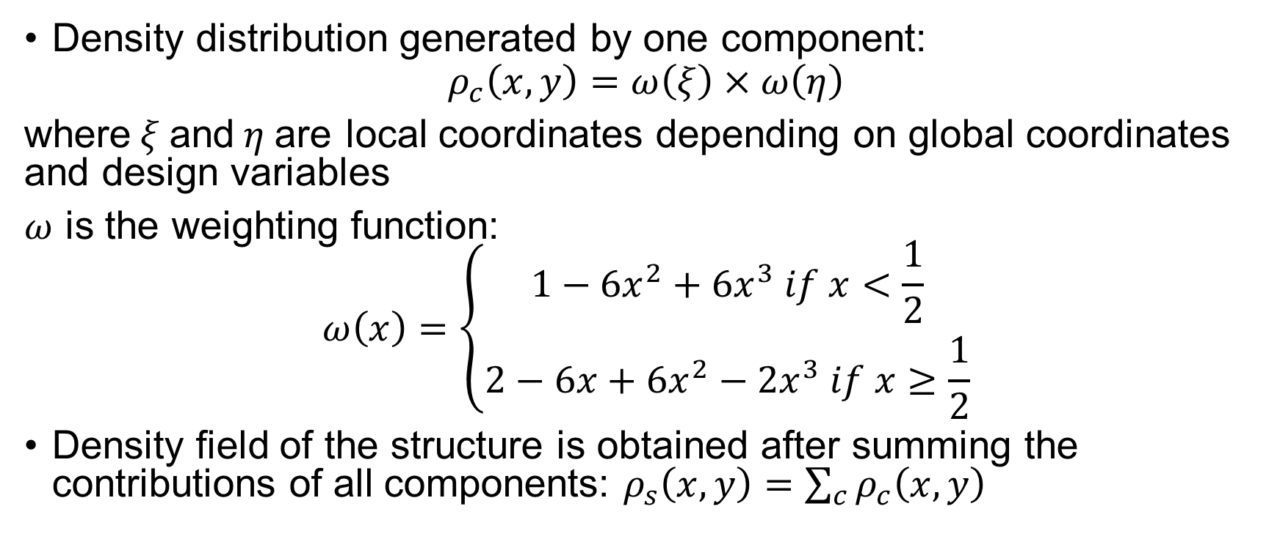
MNA scheme
Density distribution generated by one component:
$$ρ_{c}\left(x,y\right)=ω\left(ξ\right)×ω\left(η\right)$$
where$ξ$and$η$are local coordinates depending on global coordinates and design variables
$ω$ is the weighting function:
$$ω\left(x\right)=\left\{\begin{matrix}1−6x^{2}+6x^{3} if x<\frac{1}{2} \\ 2−6x+6x^{2}−2x^{3} if x≥\frac{1}{2}\end{matrix}\right.$$
Density field of the structure is obtained after summing the contributions of all components: $ρ_{s}\left(x,y\right)=\sum_{c}{ρ_{c}\left(x,y\right)}$

Slide 12
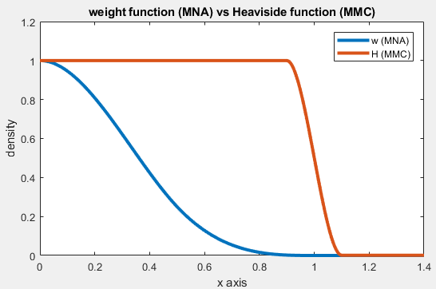
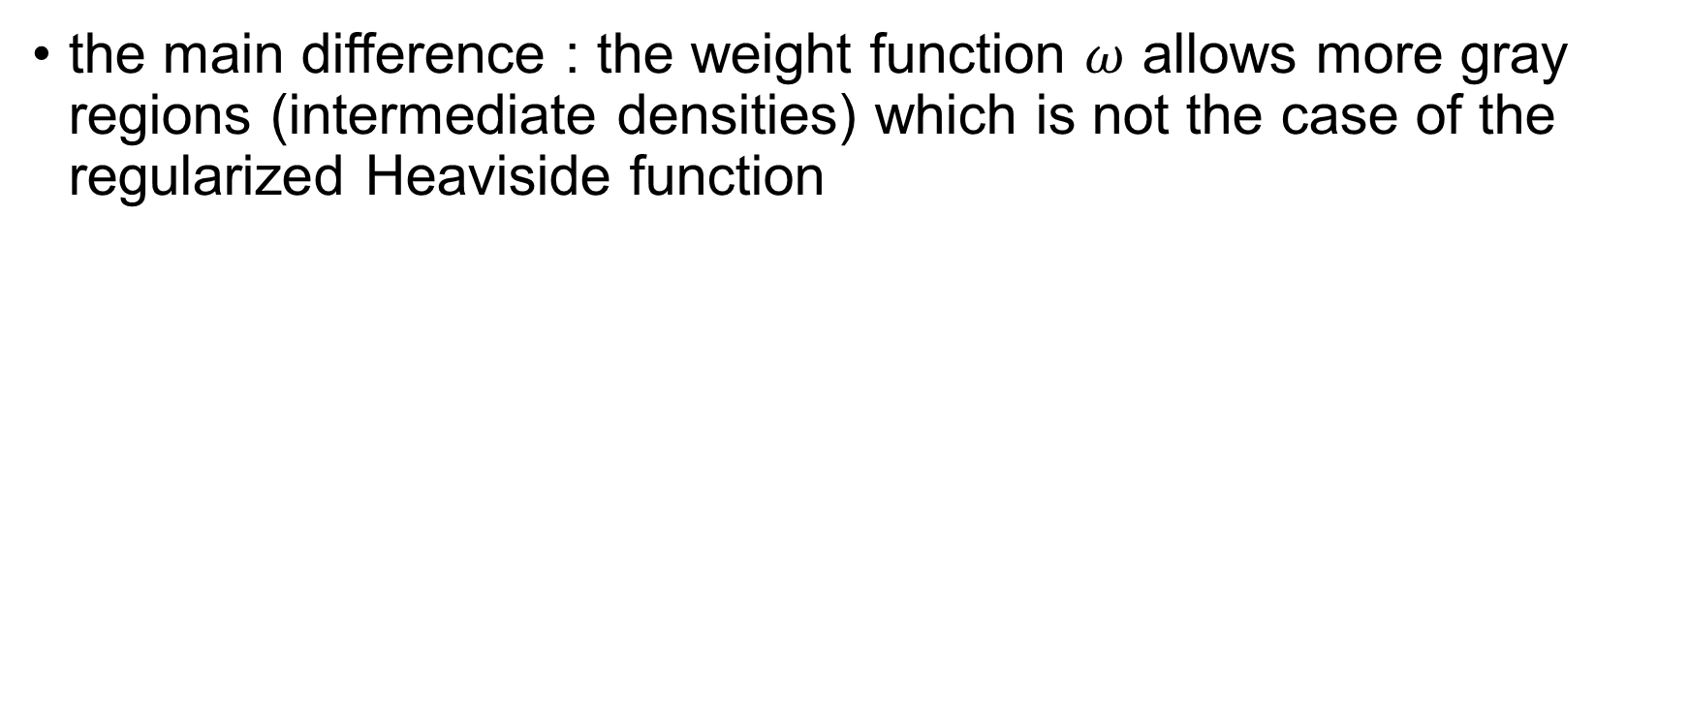
Difference with MNA
the main difference : the weight function $ω$ allows more gray regions (intermediate densities) which is not the case of the regularized Heaviside function
→Consequences:
Better and easier convergence
Better control over the structure’s shape
Design gets connected quickly
Structure become disconnected progressively

Slide 13
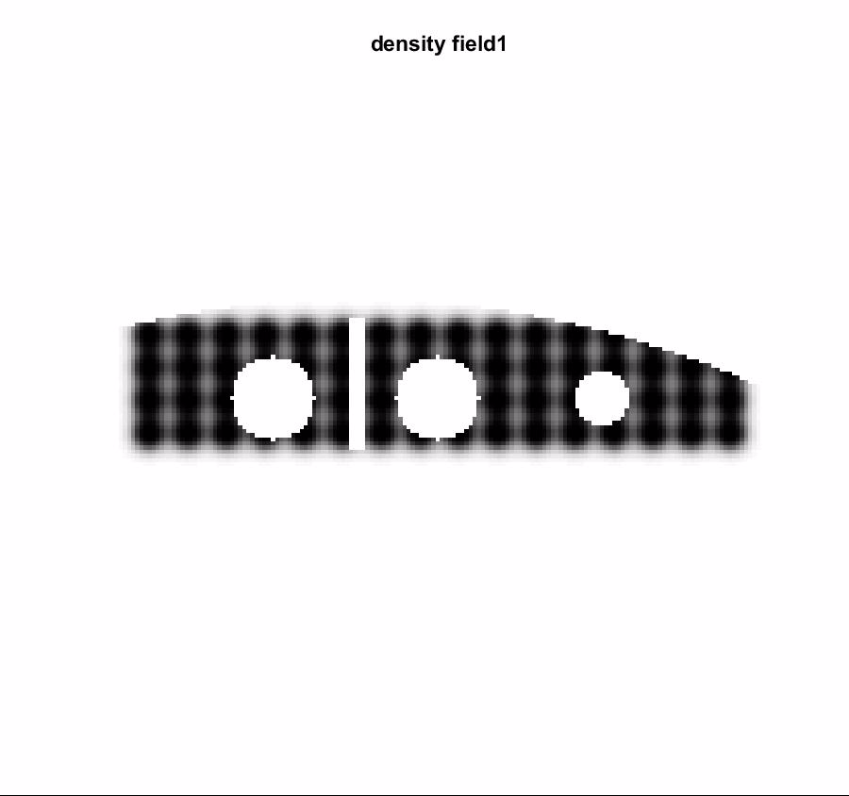
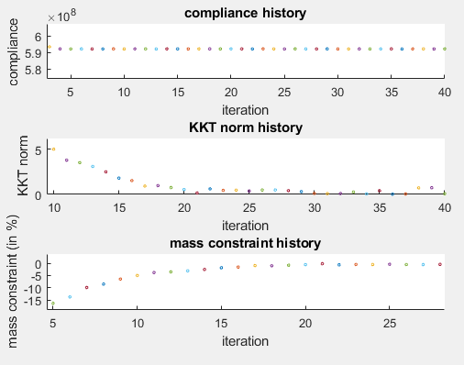
Difference with MNA
Justification
More gray regions in MNA
→ bigger components for same volume
Components can intersect each other quickly and easily
structure get connected in MNA quicker and easier than MMC

Slide 14
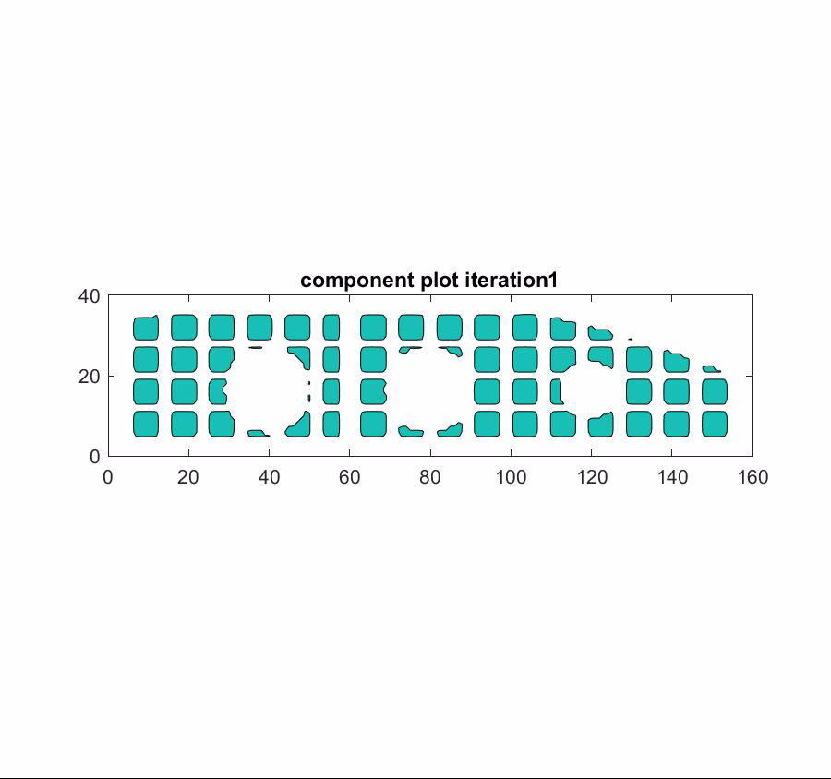
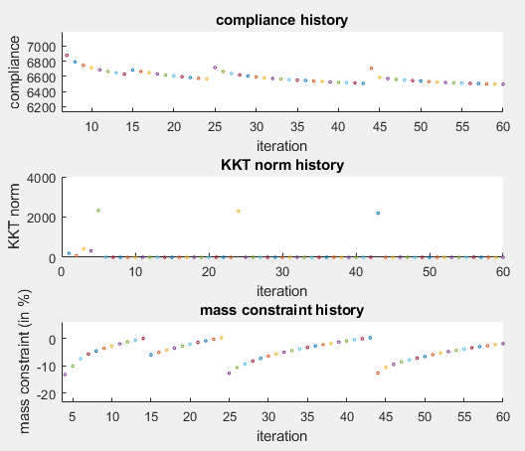
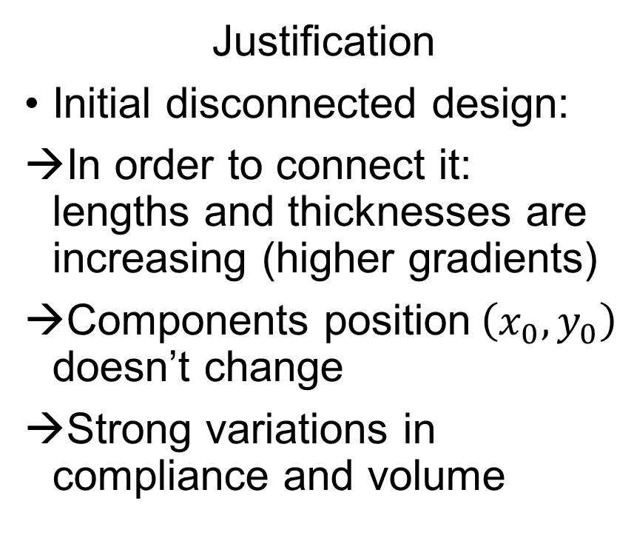
Difference with MNA
Justification
Initial disconnected design:
In order to connect it: lengths and thicknesses are increasing (higher gradients)
Components position$\left(x_{0},y_{0}\right)$ doesn’t change
Strong variations in compliance and volume

Slide 15
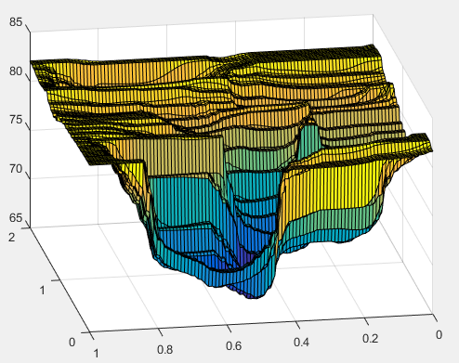
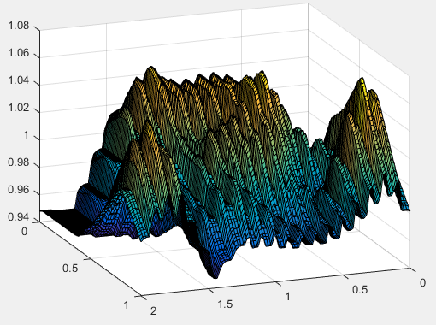
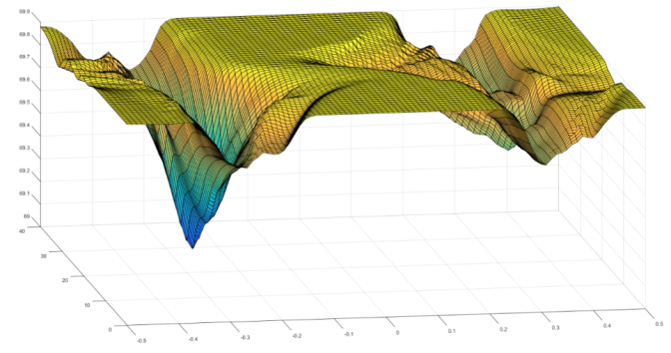
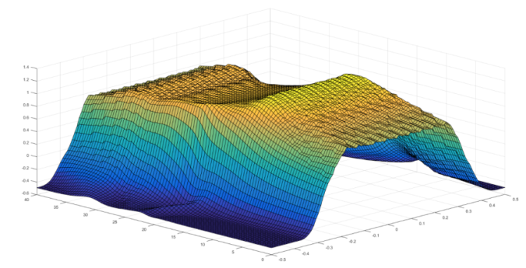
Difference with MNA
Justification
Presence of gray regions in MNA:
Compliance and volume’s variation with respect to design variables are :
Smooth in MNA
Non smooth in MMC
→ Better convergence finding minimum is easier with MNA

Slide 16
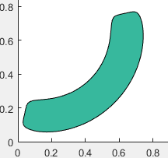
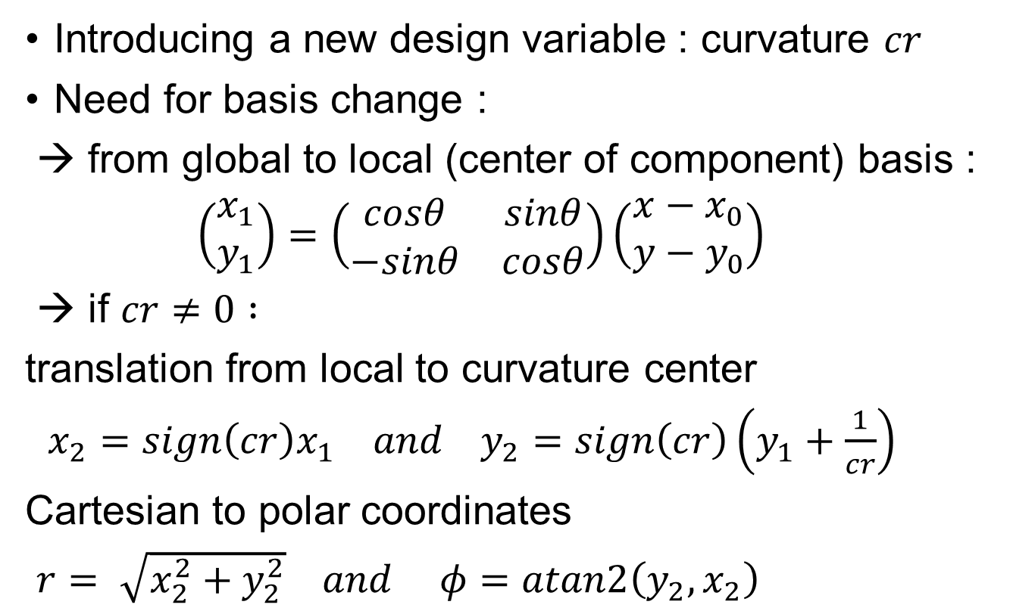


Extension to curved components
Introducing a new design variable : curvature $cr$
Need for basis change :
→ from global to local (center of component) basis :
$\left(\begin{matrix}x_{1} \\ y_{1}\end{matrix}\right)=\left(\begin{matrix}cosθ & sinθ \\ −sinθ & cosθ\end{matrix}\right)\left(\begin{matrix}x−x_{0} \\ y−y_{0}\end{matrix}\right)$
→ if $cr≠0 :$
translation from local to curvature center
$x_{2}=sign\left(cr\right)x_{1} and y_{2}=sign\left(cr\right)\left(y_{1}+\frac{1}{cr}\right)$
Cartesian to polar coordinates
$r= \sqrt{x_{2}^{2}+y_{2}^{2}} and φ=atan2\left(y_{2},x_{2}\right)$
$$r$$
$$φ$$

Slide 17
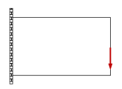
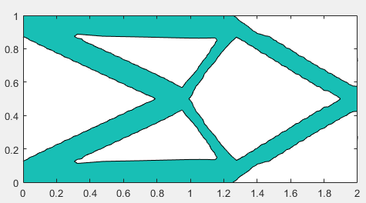
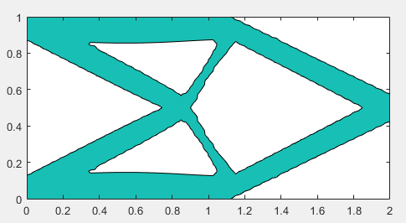
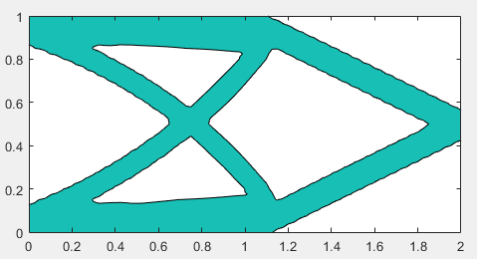
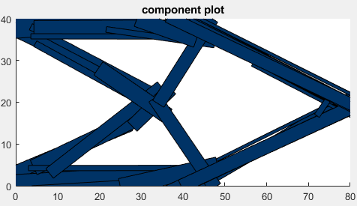

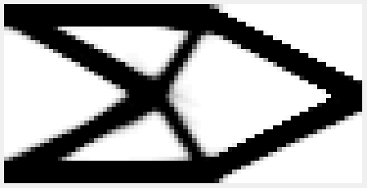
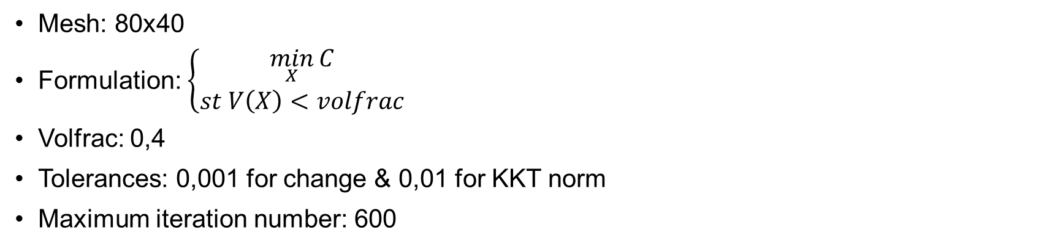
Cantilever beam
Mesh: 80x40
Formulation: $\left\{\begin{matrix}\min_{X}{C} \\ st V\left(X\right)<volfrac\end{matrix}\right.$
Volfrac: 0,4
Tolerances: 0,001 for change & 0,01 for KKT norm
Maximum iteration number: 600
DW=2
DH=1
F=1
Original MMC code
Compliance: 74,68
224 design variable
CPU time/iteration: 0,224s
Enhanced MMC code
Compliance: 73,9
224 design variable
CPU time/iteration: 0,29s
MMC with curvature
Compliance: 75,08
192 design variable
CPU time/iteration: 0,228s
SIMP (top88mma)
Compliance: 80,06
3200 design variable
CPU time/iteration: 0,37s
MNA code
Compliance: 78
160 design variable
CPU time/iteration: 0,3

Slide 18
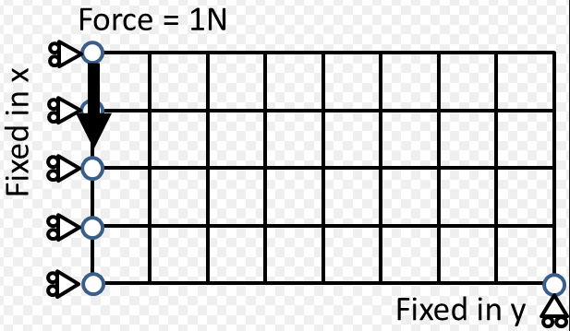
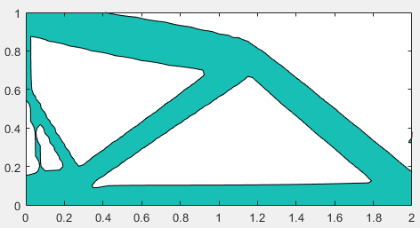
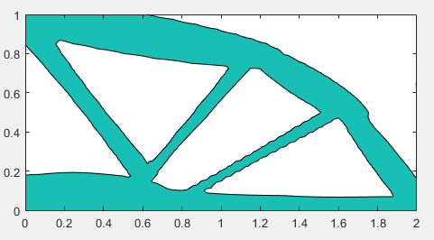
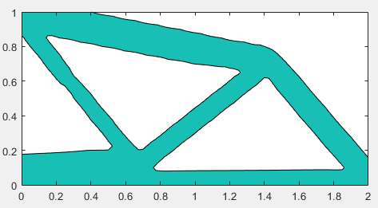
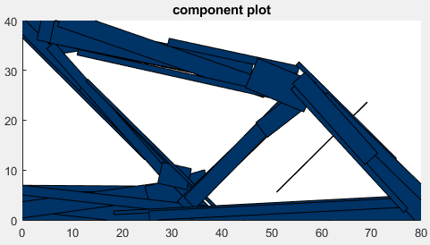
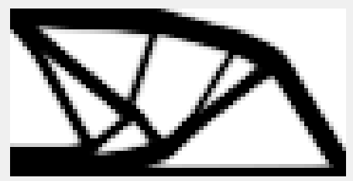
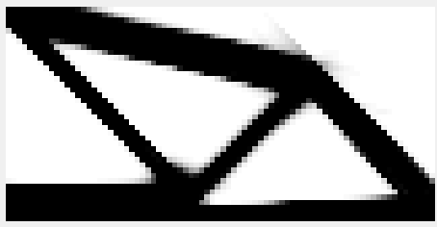
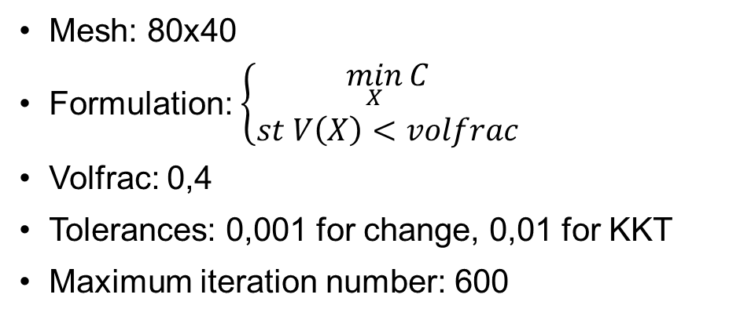
MBB beam
Mesh: 80x40
Formulation: $\left\{\begin{matrix}\min_{X}{C} \\ st V\left(X\right)<volfrac\end{matrix}\right.$
Volfrac: 0,4
Tolerances: 0,001 for change, 0,01 for KKT
Maximum iteration number: 600
DH=1
DW=2
Original MMC code
Compliance: 97
224 design variable
CPU time/iteration: 0,242s
Enhanced MMC code
Compliance: 91,19
224 design variable
CPU time/iteration: 0,29s
MMC with curvature
Compliance: 91,6
192 design variable
CPU time/iteration: 0,226s
SIMP (top88mma)
Compliance: 97,66
3200 design variable
CPU time/iteration: 0,34s
MNA code
Compliance: 95,8
160 design variable
CPU time/iteration: 0,33

Slide 19
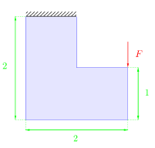
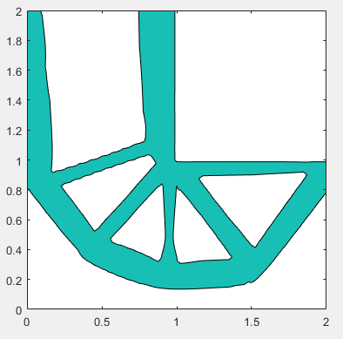
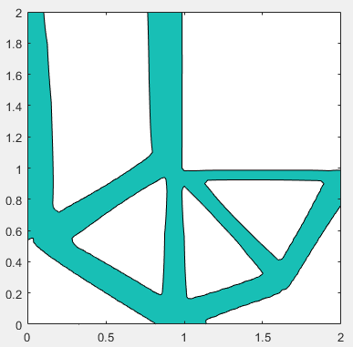





L-shape beam
Mesh: 80x80
Formulation: $\left\{\begin{matrix}\min_{X}{C} \\ st V\left(X\right)<volfrac\end{matrix}\right.$
Volfrac: 0,4*0,75
Tolerances: change:0,001 KKT:0,01(MMC) 0,002(MNA)
Maximum iteration number: 600
F=1
Original MMC code
Compliance: 98,16
336 design variable
CPU time/iteration: 0,57s
Enhanced MMC code
Compliance: 97,42
336 design variable
CPU time/iteration: 0,75s
MMC with curvature
Compliance: 96,9
288 design variable
CPU time/iteration: 0,59s
MNA code
Compliance: 97,15
325 design variable
CPU time/iteration: 0,53s
SIMP (top88mma)
Compliance: 96,66
3200 design variable
CPU time/iteration: 0,386s

Slide 20




Pylon architecture (airbus project)
 | SIMP | MNA
Compliance | 4611 | 5105
Volume | 0,1 (satisfied) | 0,1 (satisfied)
TSFC | 0,15 (satisfied) | 0,149 (satisfied)
Stress | -0,028 (satisfied) | -0,031 (satisfied)
Iterations | 230 | 400
Time/iteration | 4,5 | 8s
Design variables | 7600 | 5x5x5x9=1125
Components plot
Density field SIMP
Density field MNA
Initial design

Slide 21
Conclusion
Enhanced MMC code is more efficient
Curved components show good results and enrich MMC formulation
MMC has more ability to explore design domain and leaves local optimums easier than MNA
MMC is very accurate and gives good results but very sensitive to optimizer parameters and initial configuration
In MNA: less need for tuning, much less sensitive to initial point
MNA worked for all test cases but not MMC!

Slide 22

Limitations/Perspectives
LIMITATIONS
More complex geometry description→$\left\{\begin{matrix}expensive sensitivities \\ optimization non linearity\end{matrix}\right.$
Gradient based methods → risk of finding local optimum
Gray regions can remain if not enough components used
PERSPECTIVES
Implement analytical gradients$\left\{\begin{aligned}in MMC \\ for curvature in MNA and MMC\end{aligned}\right.$
Implement MMC efficiently for 3D airbus case (irregular mesh)
Improve the components plot given by MNA

